Slide 1



Washington State Open Data Portal
Andrew Mckenna-Foster
Summer 2019
Notes:
This is not as hard hitting and concise as it should be. The core metadata figures need to be clearer. Need to cut more.

Slide 2
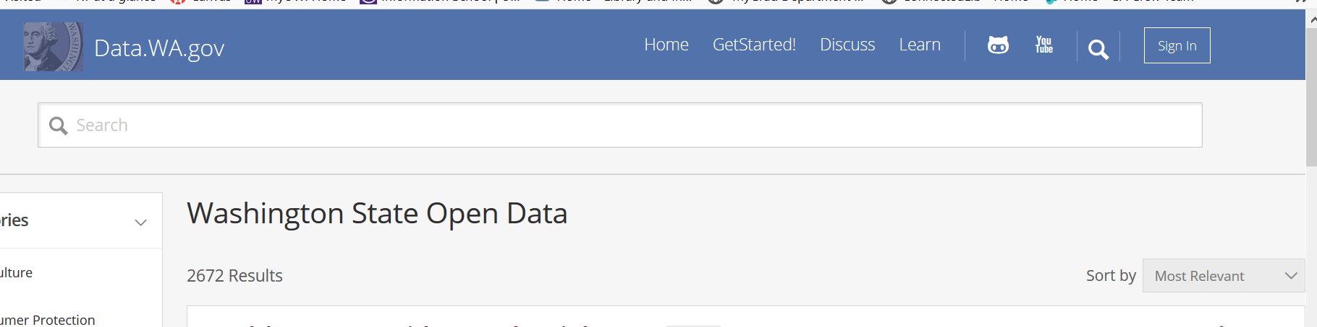
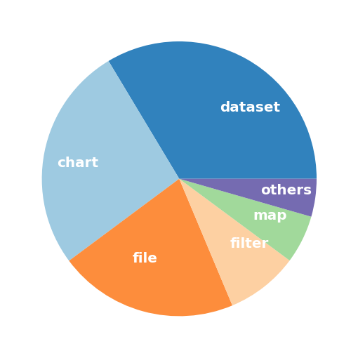
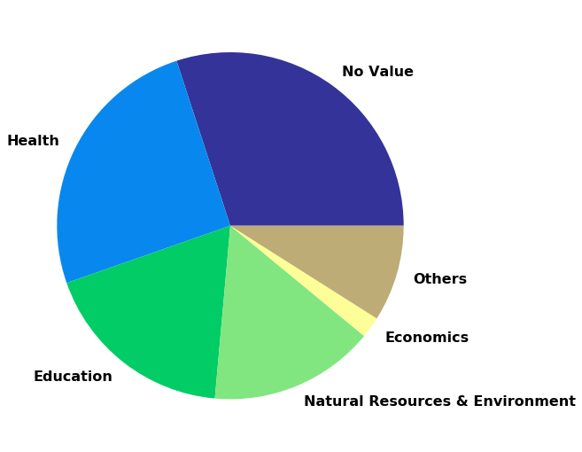
Started in 2012
> 2,600 assets
> 800 datasets
> 30 state agencies
Notes:
One of the more established state portals. Brief overview.
One reason for success (unmediated deposits) is also a possible cause of problems (poor metadata) – foreshadow with category pie chart.

Slide 3
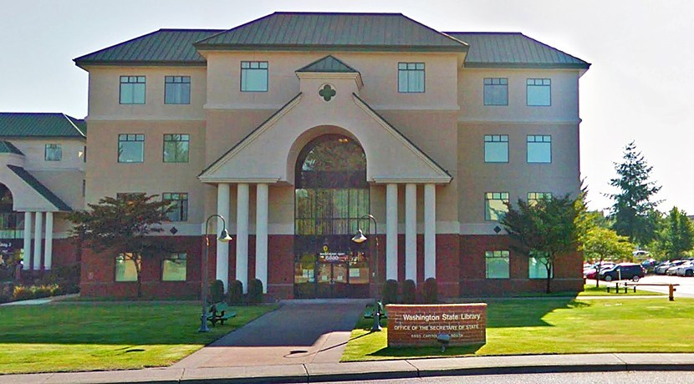
How can the State Library help curate this open data portal?
Notes:
Is there a curation role for the State Library and what would that work look like?

Slide 4
Project Overview
Interview agencies that publish to the portal
Publishing behavior
Portal assessment
What have others done?
Metadata existence
Data and metadata quality
Notes:
Focused on two things

Slide 5
Agency Interviews
Portal Use
Users
Future Plans

Slide 6
The Agencies
Interviewed 8 agencies and 1 user
A range of data publishing behaviors:
Number of datasets
Number of downloads
Open data plan completion

Slide 7
Agency Publishing is Diverse
Publishing Behaviors:
User focused
Upload and forget
Internal use
Transparency
Agencies view the portal positively
Users:
Other agencies
NGOs
Local governments
Federal agencies
3rd parties
Citizens
Most plan to continue or increase publishing

Slide 8
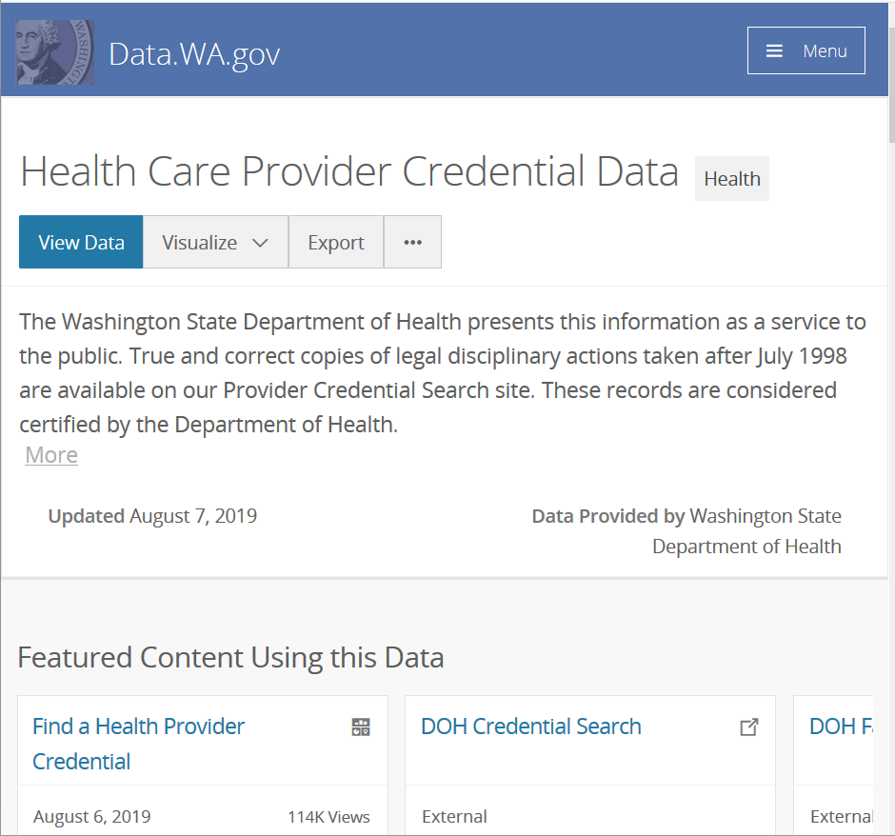
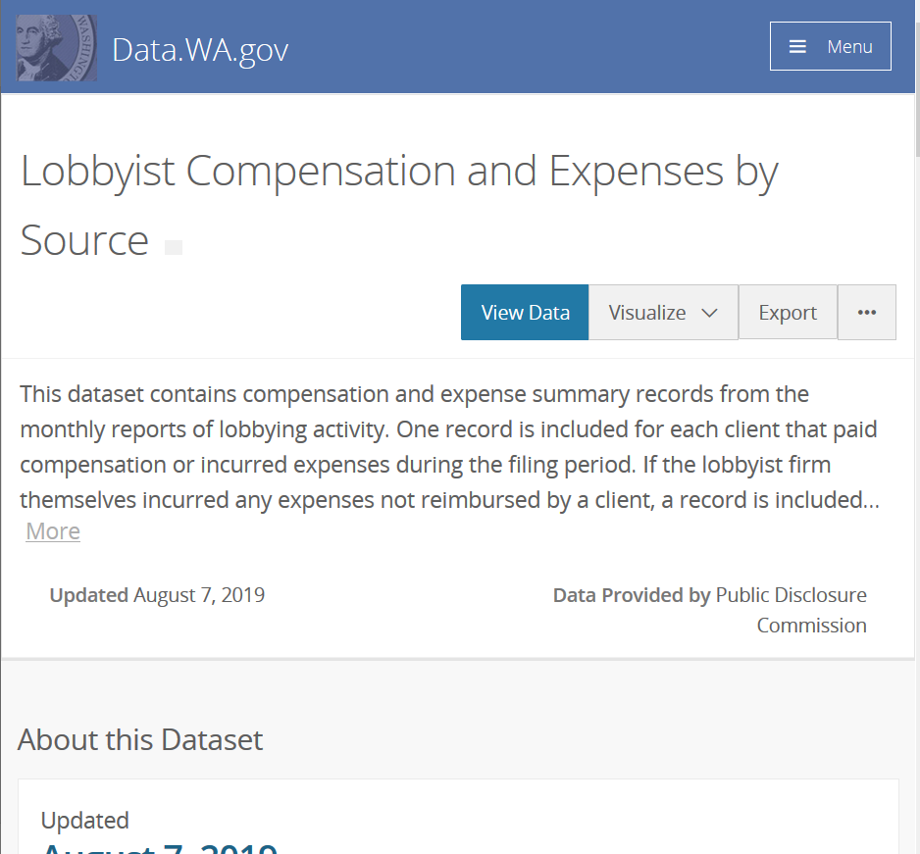
Notes:
Power publishers

Slide 9
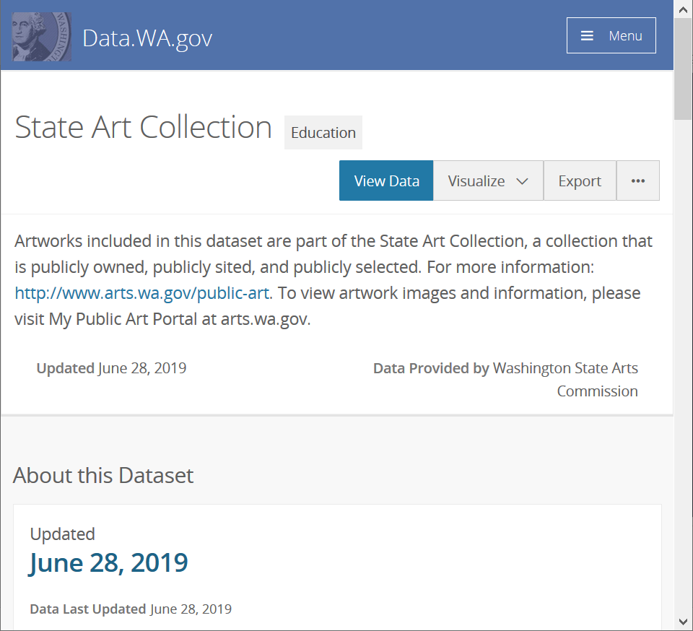
Notes:
Small publisher interested in doing more.

Slide 10
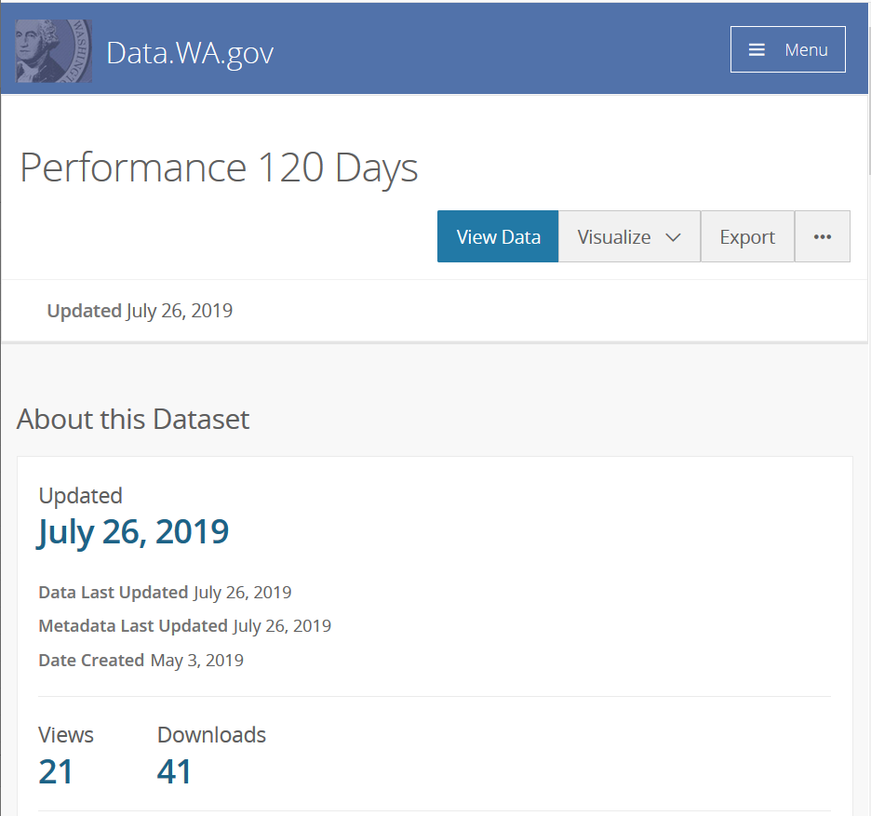
Notes:
Publishing for internal agency use
Data.wa.gov has lots of different datasets, agencies use it in many different ways. Raises the questions- do state portals show unique collections of data that possibly reflect the needs of that state? Especially compared to cities?

Slide 11
What does this mean for curation?
Curator will need to work closely with publishers
The average citizen is not the main user
Data.wa.gov will have a unique composition of datasets
Library expertise will be valuable here
Notes:
One will not find the same types of datasets at the top of every state portal. Curation work cannot be generalized- cannot look to other state portals to guide collections development type work.
Using other state portals to guide curation may not work
Curation cannot be generalized
Requires specific skills and knowledge
State Library may have these skills

Slide 12
Metadata Assessment
Existence
Quality & Understandability

Slide 13
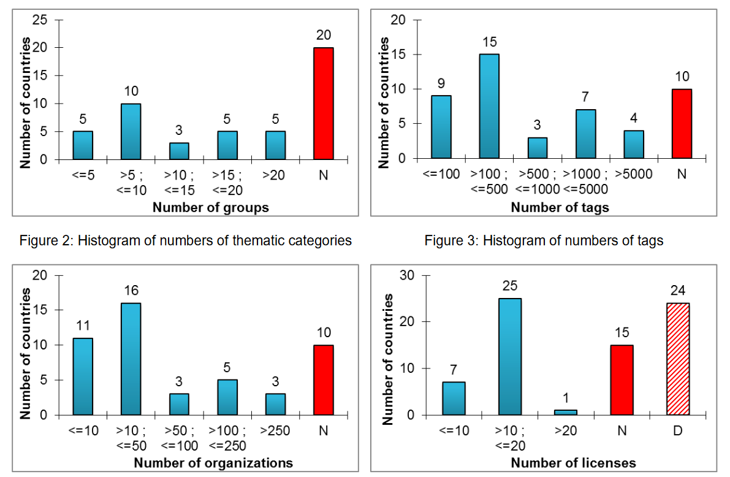
Low Quality Metadata - A Global Issue
“Open data quality – the next shift in open data?”
Open Knowledge Foundation 2017
Machova and Lnenicka 2017
Vetrò et al. 2016
Kubler et al. 2018
Umbrich et al. 2015
Notes:
Umbrich et al. 2015 - Majority datasets are around 60% complete
Vetrò et al. 2016 - ~90% compliance with e-Gov Metadata Standard
Machova and Lnenicka 2017 – Metadata quality averaged 65% +/- 11
Kubler et al. 2018 – Most portals fail to include temporal, spatial, license

Slide 14
Four Important Dimensions for Assessment
Format
Findability
Owner Information
Temporal Information
Also important:
License
Data Dictionary
Notes:
License is often considered very important but in the case of data.wa.gov, agencies may purposively leave it blank if they believe that data to be public from its origination (agency legal counsel may recommend this).

Slide 15
Metadata Existence
Notes:
License, temporal values, originator and metadata language are least filled out.

Slide 16
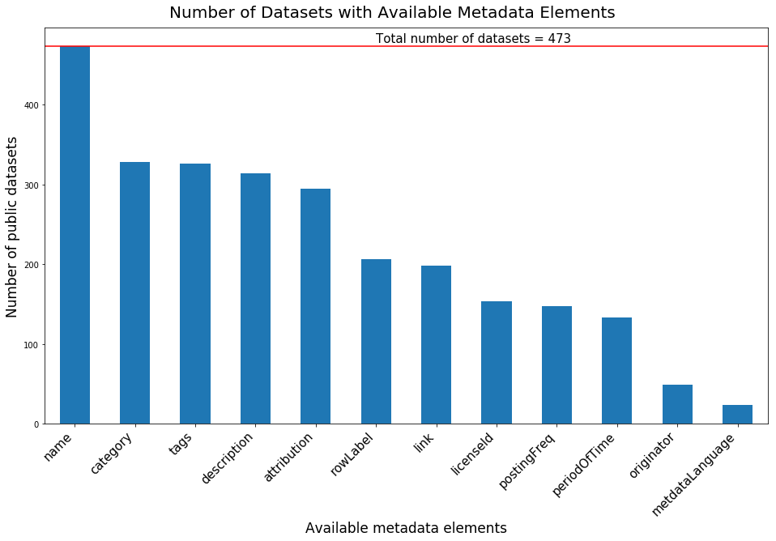
Notes:
License, temporal values, originator and metadata language are least filled out.

Slide 17
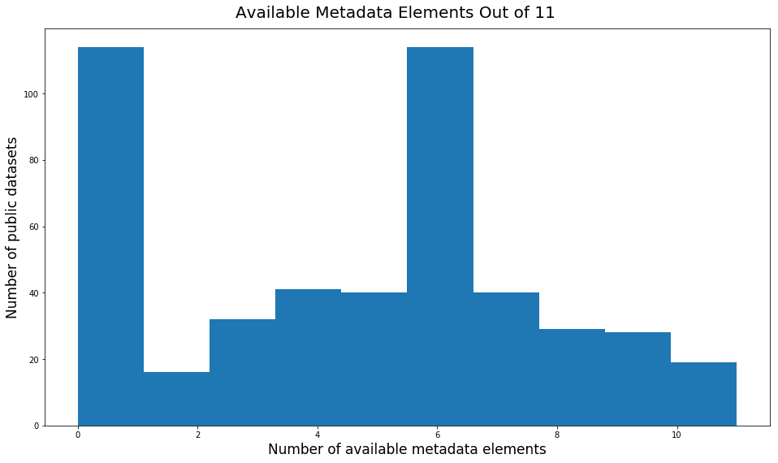
Notes:
Most datasets have 6 or fewer elements filled in. Note that many fill in none of the elements.

Slide 18
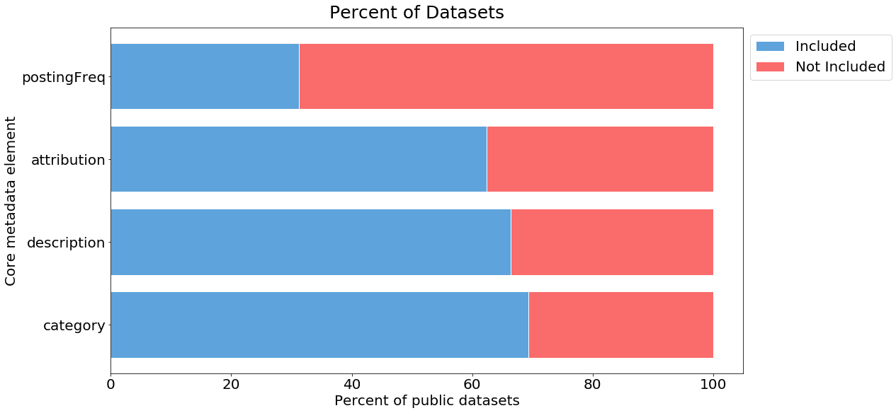
Notes:
Many datasets have at least one of the core elements complete. Over 20% have none though. Posting Frequency is rarely filled in.
Kubler et al 2018: Ckan portals. See fig 9 Qe(dis) [discovery] ~60%, Qe(tm)[temporal] ~0%, Qc(lic)[license]~25%, Qe(con)[contact]~75%. Didn’t really have an owner element.

Slide 19
Quality and Understandability
112 datasets Stratified random sample
Assessed:
Title, Description, Temporal Information, Spatial Information
Data Dictionary
Data Accuracy (values consistent in format?)
Curation Needs
Notes:
117 datasets selected, 5 had disappeared by the time I got to them.

Slide 20
Notes:
Temporal: about 23% were confusing, Of all the datasets, 14% had incorrect temporal information. Many titles are enigmatic, few provide data dictionary
Few papers mention data dictionary. Vetro et al 2016 does, few to none of the datasets they looked at had metadata for the columns at the municipal level- national level had good dictionaries.

Slide 21
Dataset Titles
Snake Harvest
Master Content
DEL Office Locations
Snake Final Abundance 01022013
Coast Complete Metrics
Imaged Documents and Reports
WDFW-Adult Returns
Notes:
There are some mystifying titles

Slide 22
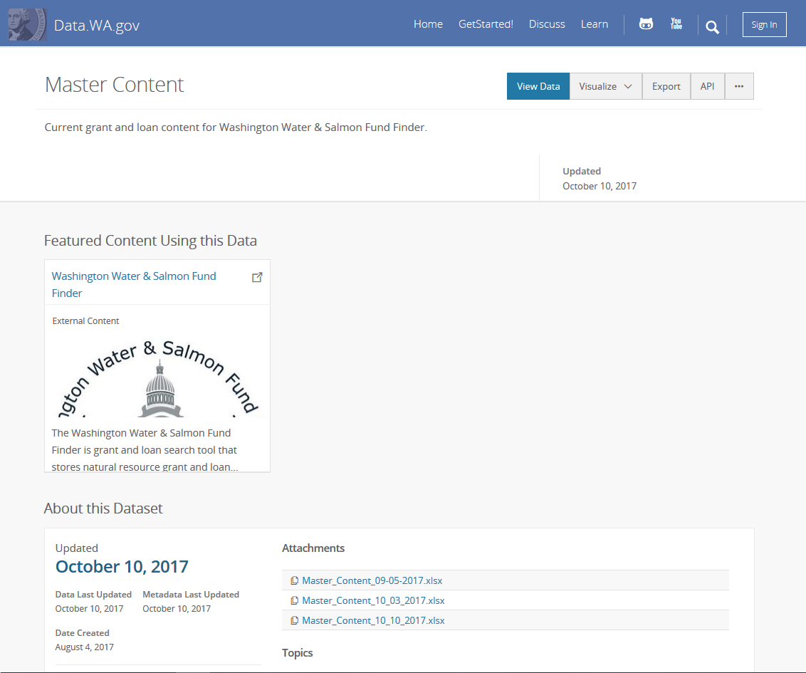
Notes:
Temporal problem

Slide 23
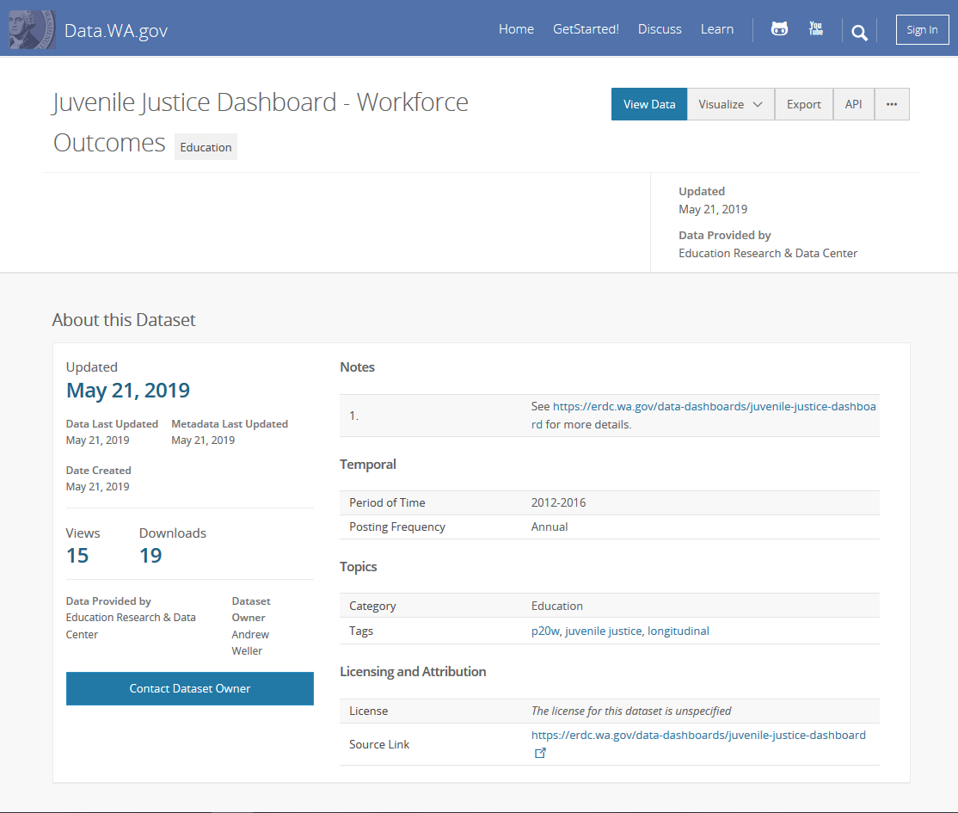
Notes:
Temporal problem

Slide 24
Curation Needs
Multiple datasets in a time series
Uploads that are not data
Mystery datasets
E.g. “1 – All $$ By Biennium” with no metadata.
Completely empty uploads and test/dummy datasets
Notes:
Multiple datasets in a time series
Uploads that are not data
E.g. links to pdfs
Mystery datasets
E.g. “1 – All $$ By Biennium” with no metadata.
Completely empty uploads and test/dummy datasets

Slide 25
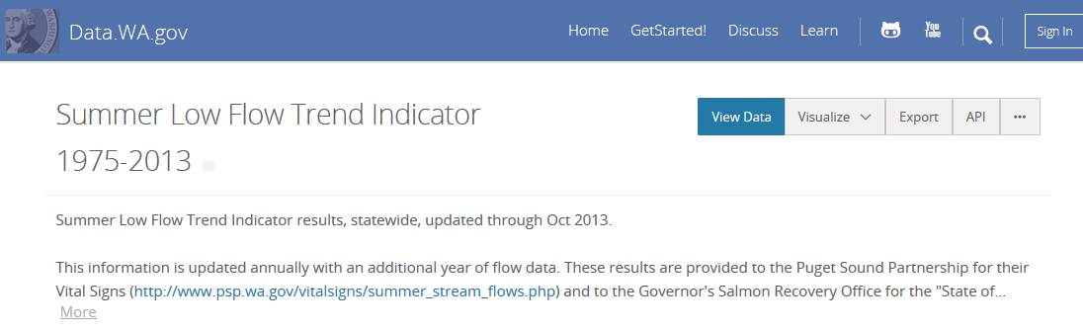
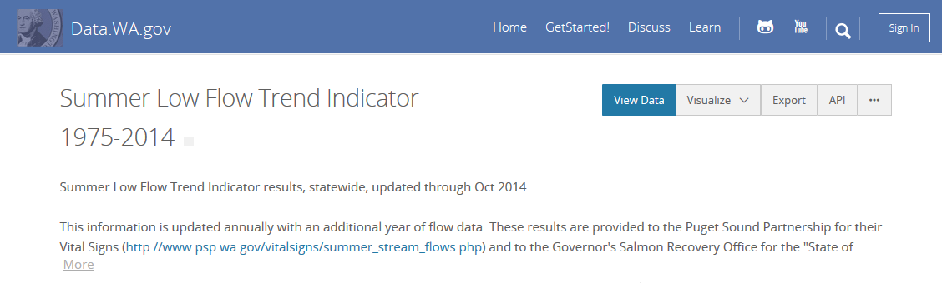
Notes:
13% of sampled seem to be candidates for an annually updated dataset.

Slide 26
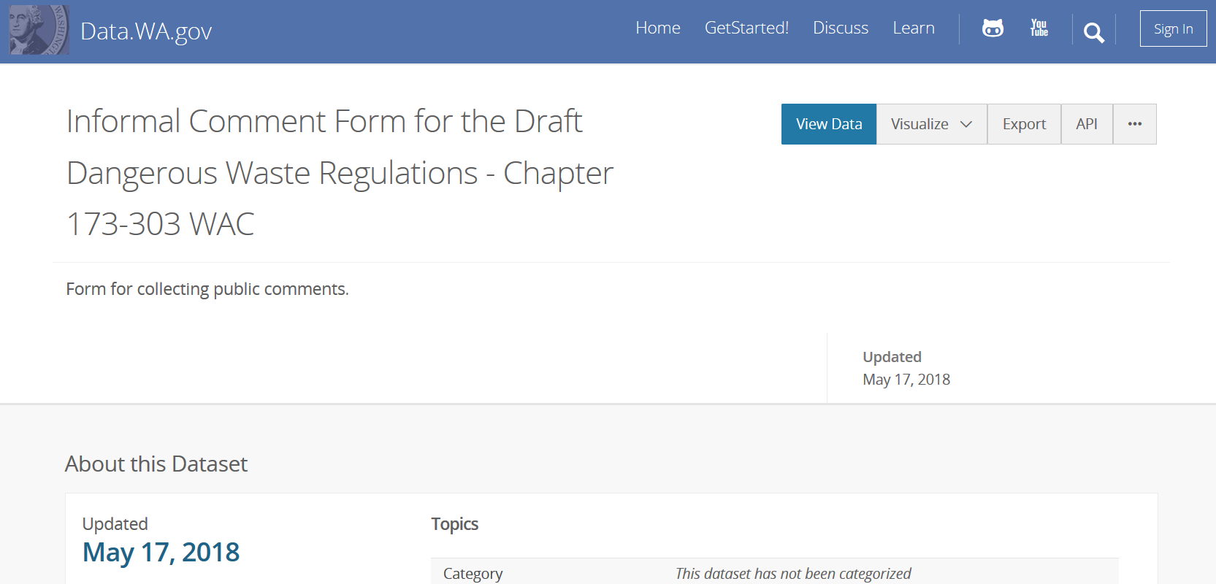
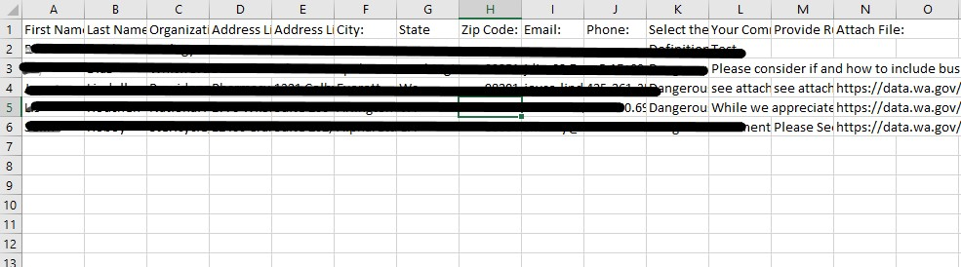
Notes:
Perhaps better on an agency website?

Slide 27
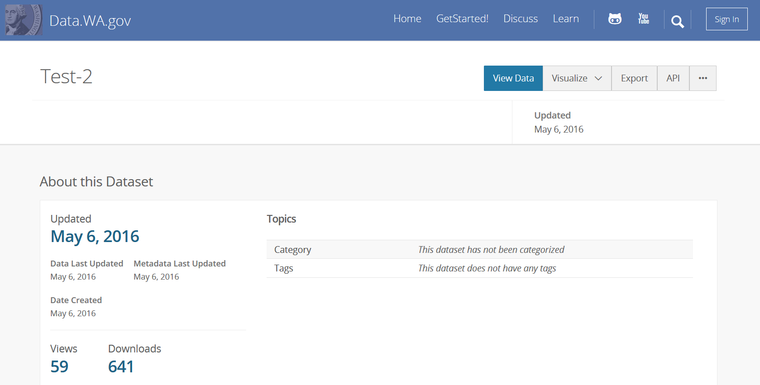
Notes:
Test dataset

Slide 28
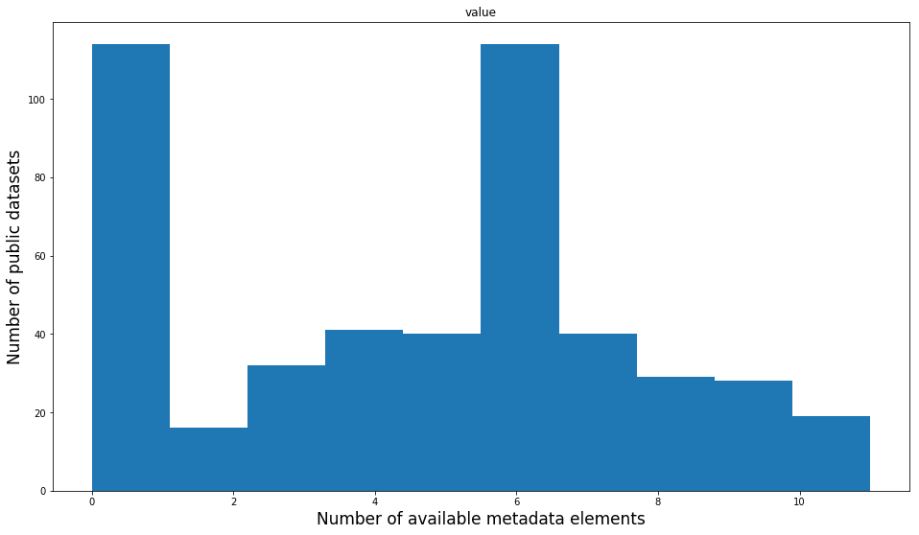
Quick Review
Agencies use the portal to meet their unique data needs
Data.wa.gov will reflect WA distinctiveness
Incomplete/poor quality metadata and data
Searching and comprehending are difficult
Notes:
Here are the major findings.

Slide 29
Recommendations

Slide 30
Insights
Data.wa.gov cannot be developed and weeded like a traditional library collection
A cookie cutter solution is unlikely
Curation will be a combination of facilitating publishing, working with publishers, and making small edits
Notes:
Cannot control selection without completely changing how the portal operates. Its success is partly due to its low barrier to publishing

Slide 31
What’s Next - Recommendations
Focus curation on the core metadata elements
Remove datasets that should not be public (not data, test)
Create stories to increase portal visibility
Create a user feedback system
Run regular metadata assessments
Notes:
Focus curation on the core metadata elements
Add controlled vocabularies where possible
Fix obvious temporal errors
Make titles understandable
Remove datasets that should not be public (not data, test)
Create stories to increase portal visibility
Create a user feedback system, Run regular metadata assessments

Slide 32
Questions
Presentation and all supporting material available at:
https://github.com/OpenDataLiteracy/WSL-AMF
Acknowledgments:
Kathleen Sullivan, Will Saunders, Evelyn Lindberg, the staff at the State Library, the ODL Team, and all the agencies that assisted in gathering information.

